Slide 1
scientific writing and paper review example
Anuar santoyo 安武
2023/03/07

Slide 2
TABLE OF CONTENT
Scientific Writing
Paper Explanation
Paper Review

Slide 3
Scientific writing
Brief introduction

Slide 4
Scientific writing
What is it? (Use Tim example)
Manuscript that shares to the public an original scientific research work.
Why is it hard to write?
Trained to do science not share it (skill developed not knowledge obtained)
Scientist need both: good science skills and good communication skills (smart guy, bad teacher)

Slide 5
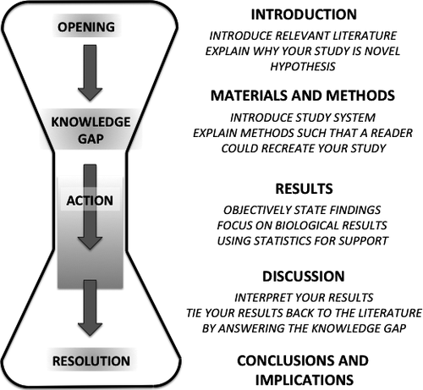
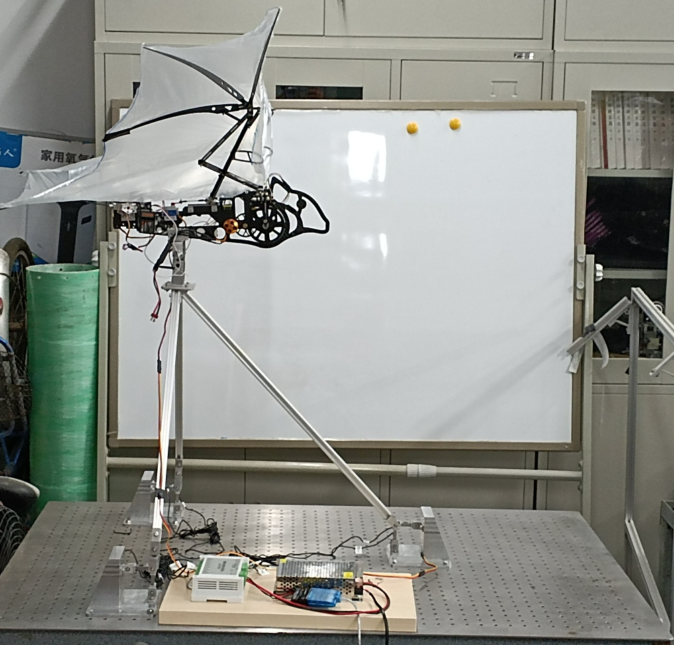
Scientific writing
How to write a good scientific paper
Batbot example?

Slide 6
Scientific writing
The Abstract
What people read to decide if your paper is worth to read. (movie trailer comparison)
Describe the background for your study
Clearly state the research problem
Briefly describe the methods used to investigate the problem
State the results obtained
Summarize your conclusions and link these back to the study context

Slide 7
Scientific writing
Tips for writing a paper
Have a clear message
Tell a story (mention not letting go baby research)
Daily Journal
Perfect Sentence Vortex
Skill to develop, not knowledge to obtain

Slide 8
Paper explanation
Theoretical background

Slide 9
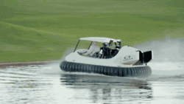
Paper explanation
“Fusion Bacterial Foraging and Particle Swarm Optimization Algorithm For An Autonomous Hovercraft Control”
Main Goal: Develop controlling algorithm for hovercraft.
What is a hovercraft?
https://gifer.com/en/D6T

Slide 10
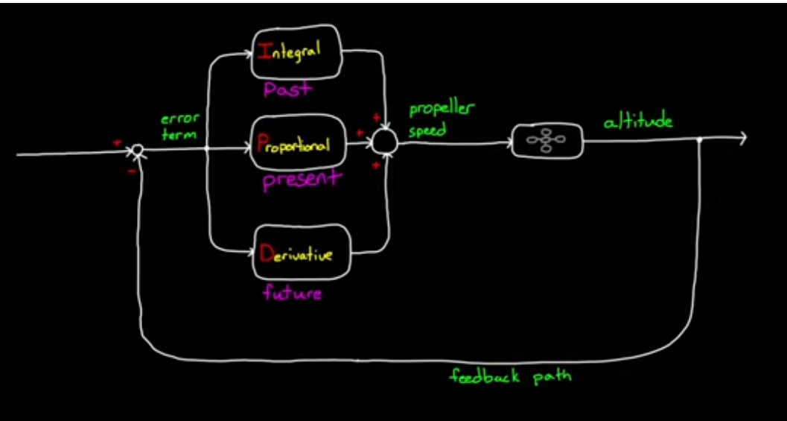
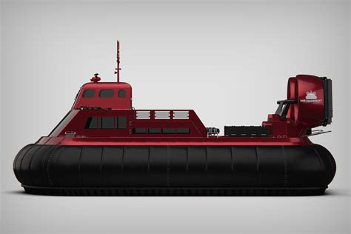
PAPER explanation
What is a PD Controller?
https://tse2.mm.bing.net/th?id=OIP.3S-ugFBq5lCiFg_EQhmwIAHaE8&pid=Api
Goal

Slide 11
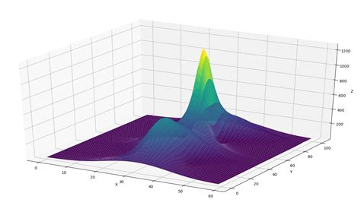

PAPER explanation
What is an optimization algorithm?
volume
speed

Slide 12
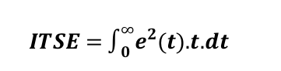
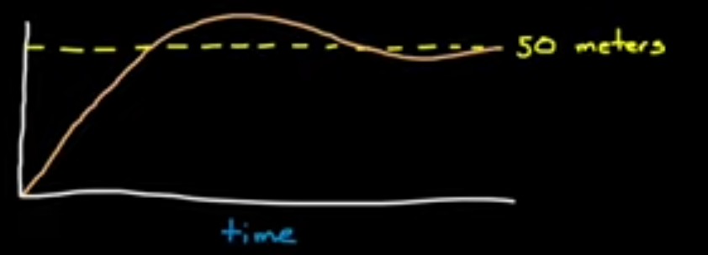
PAPER explanation
What is the paper optimizing?
Kd
Kp

Slide 13
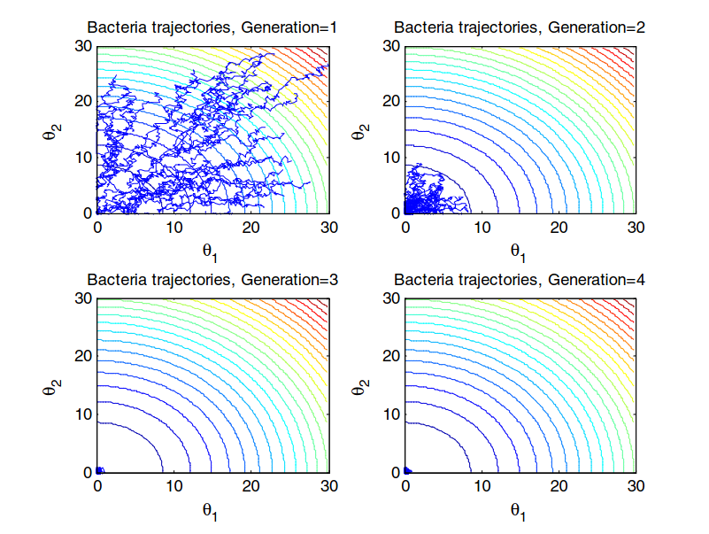
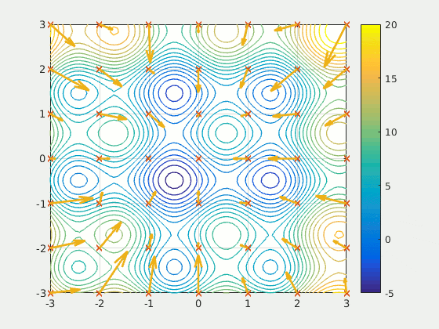
PAPER explanation
How are they optimizing?
Bacterial foraging
Particle Swarm Optimization
https://youtu.be/_bzRHqmpwvo

Slide 14
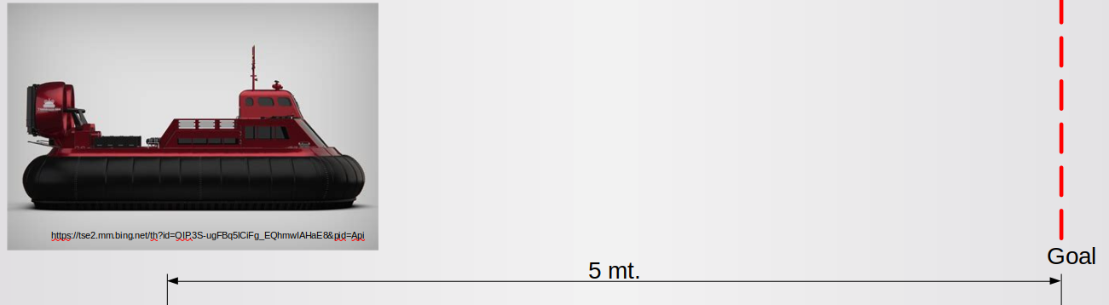
Paper explanation
Recap:
Want to control hovercraft with PD controller
Use fBF-PSO to find optimal Kp and Kd

Slide 15
Paper review
Demonstration of a journal review

Slide 16
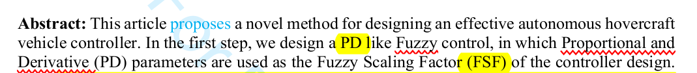
Paper review
Abbreviations
Must be defined once before using them
Must be congruent
If <3 used, not necessary
Used before declaration

Slide 17
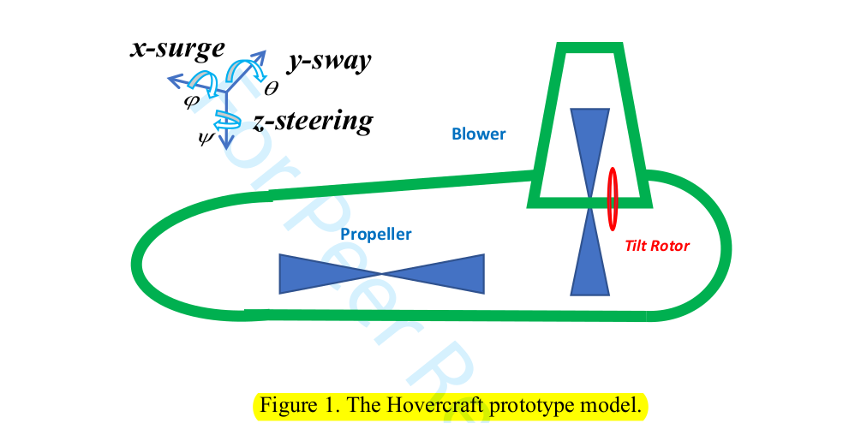
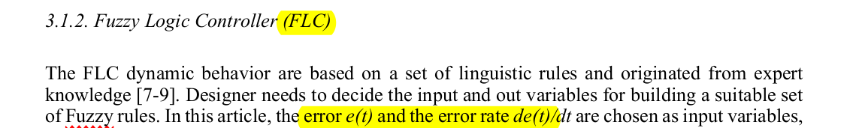
Paper review
Reproductivity
Paper must be reproducible
Poor description of model
Error and error rate not explained

Slide 18
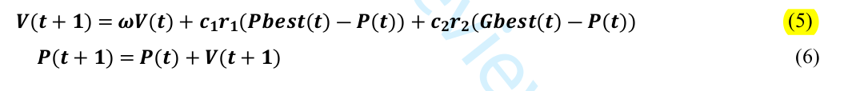
Paper review
Scientific format
Write formulas using specialized software (ej. LaTex), not plane text.
No indices, no subscript

